Slide 1
Wanna See a UFO?
Connor, Tom, Marisabel, Amy, Brian

Slide 2
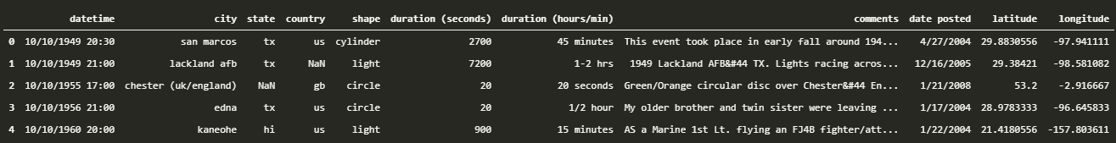
Motivatoin
National UFO Reporting Center
Data on reported UFO sightings dating back to 1949
Original CSV downloaded from Kaggle
Date/Time, City, State, Shape, Summary
Analyze data to try and make predictions about likelihood of UFO sightings in different areas
Further analysis into other attributes to help increase the chance of a UFO sighting

Slide 3
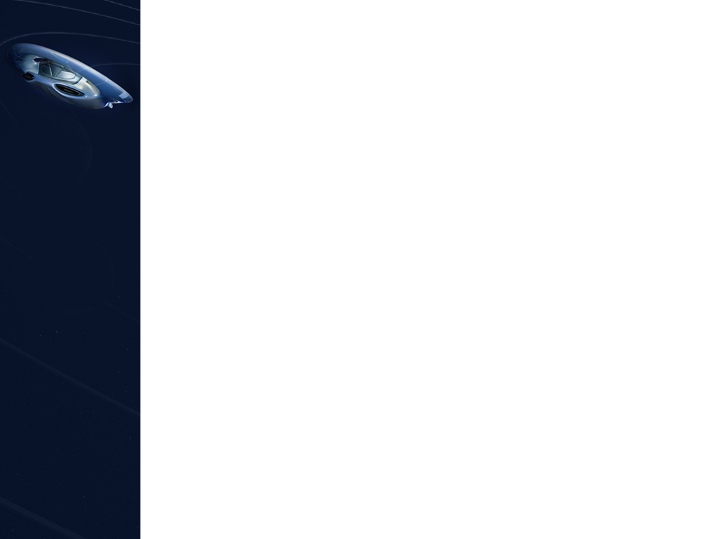
Summary
Does the population of city/state/country affect the rate of UFO sightings?
Is it better to be somewhere with a lot of people, or somewhere more sparsely populated?
What are the most common shapes?
What is the best shape/UFO to try an look for?
What dates/times produce more UFO sightings?
When are the best times of day to go outside?
Are there any common themes in the descriptions of the UFO sightings?
Are there any other details we can pull out from the summary to try and get a more immersive experience?

Slide 4
Questions
Does the population of city/state/country affect the rate of UFO sightings?
City/State from the NUFORC data
Population from the Census
What are the most common shapes?
NUFORC data
Potentially needs cleaned up
What dates/times produce more UFO sightings?
NUFORC data
Split into time periods (day vs. night, dawn vs. dusk, etc.)
Are there any common themes in the descriptions of the UFO sightings?
NUFORC data
Word cloud, Flesch-Kincaid score

Slide 5
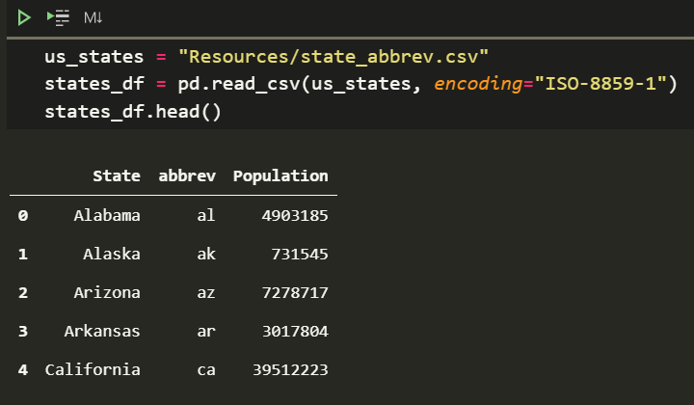
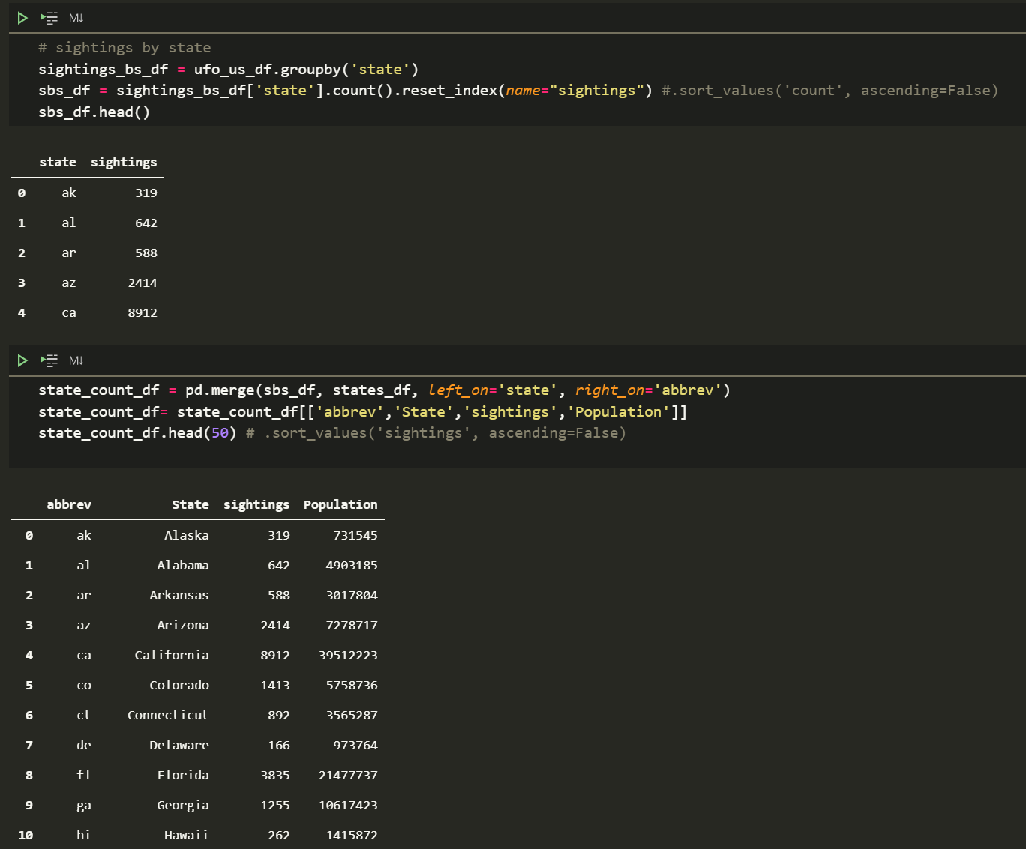
Getting Population Data

Slide 6
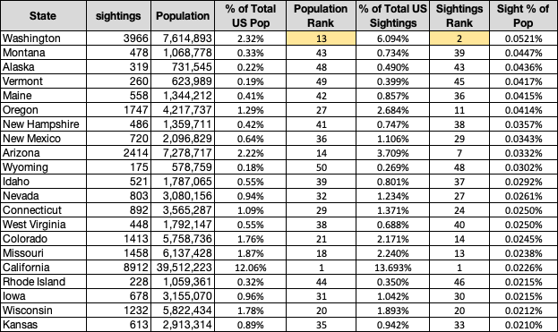
Interesting Population Insight

Slide 7
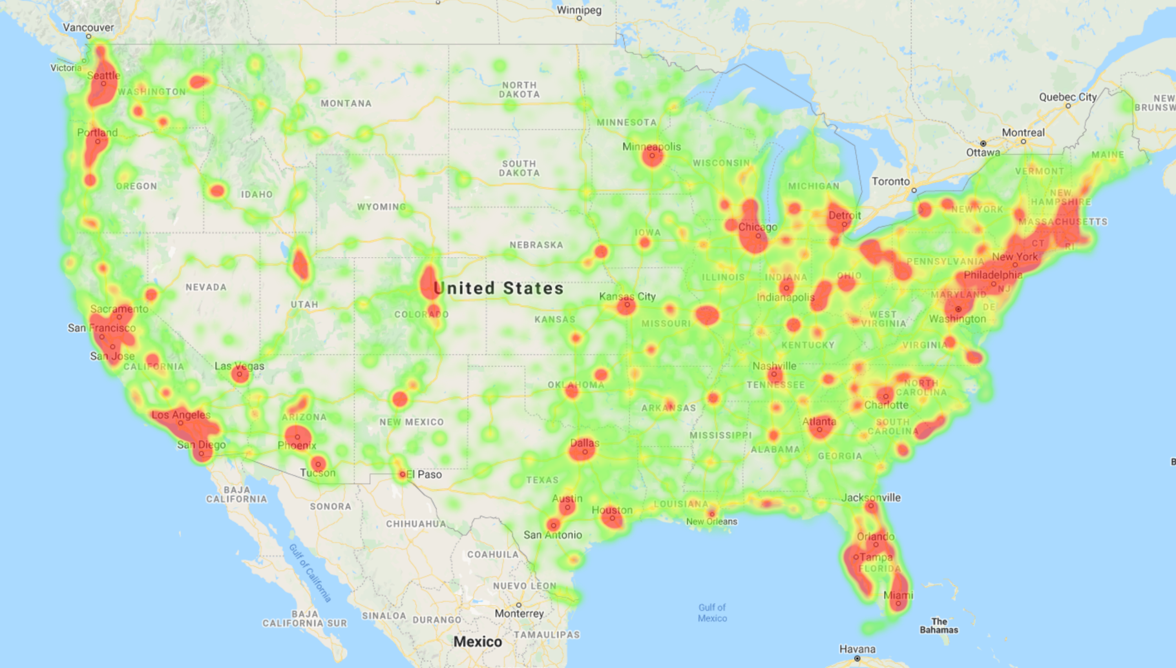
Heat Map of UFO Sightings

Slide 8
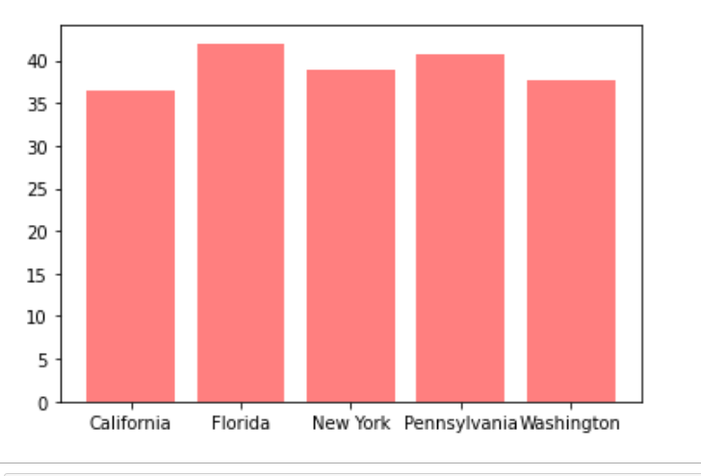
Median Age in Top 5 States

Slide 9
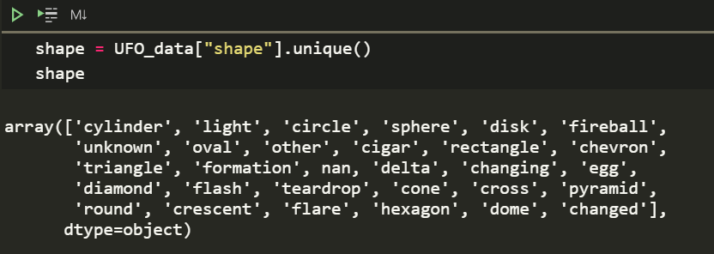
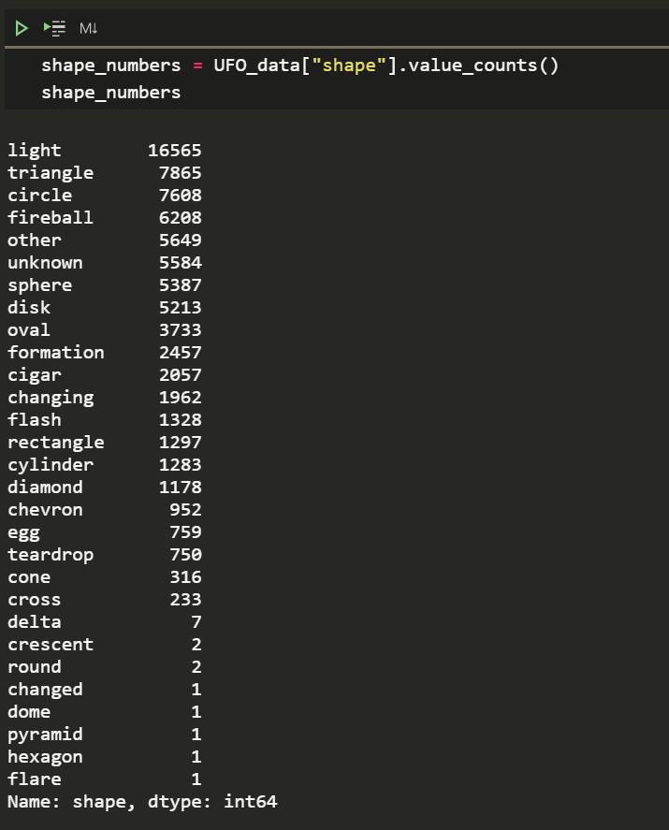
Shape Overview

Slide 10
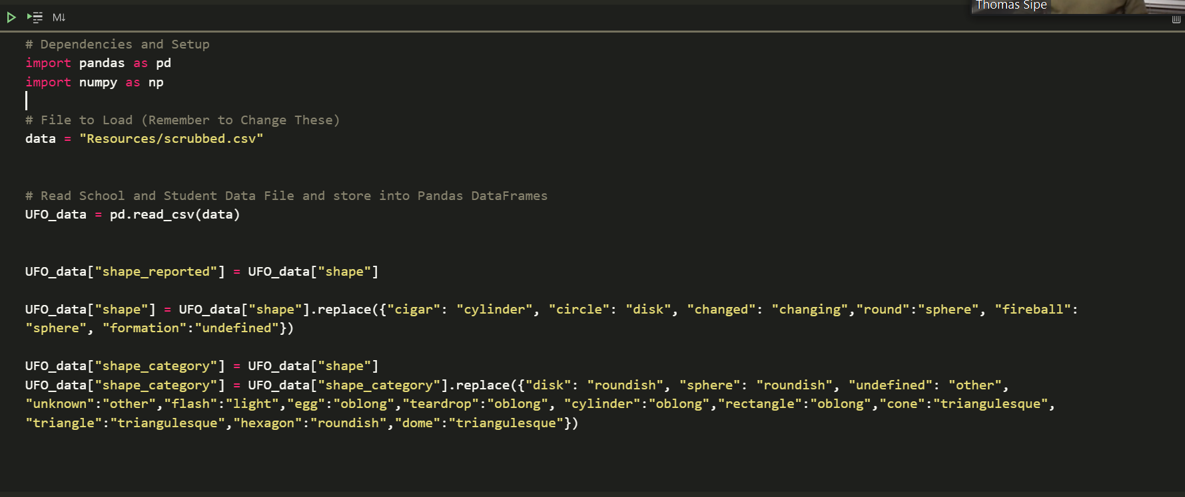
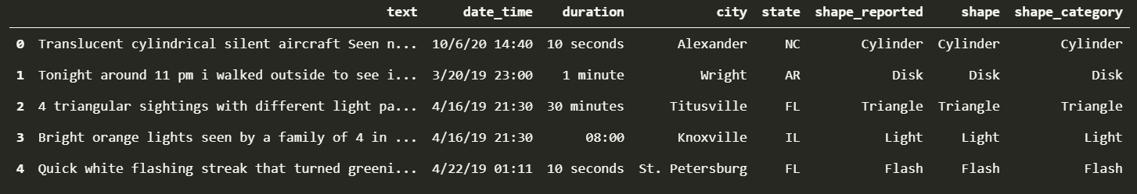
Combining Shapes

Slide 11
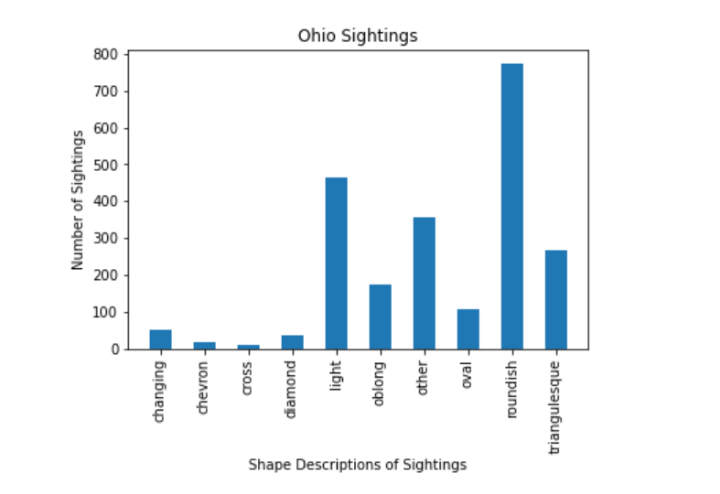
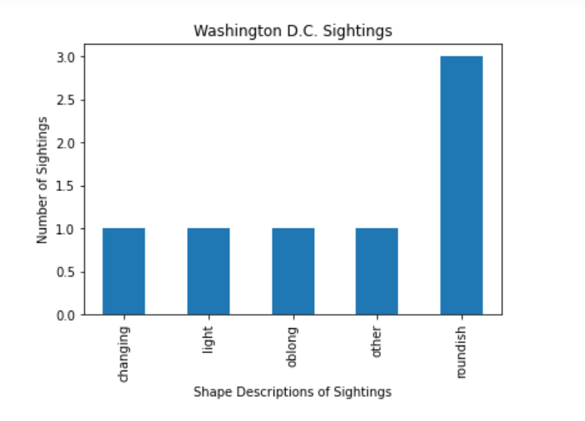
Sightings by Shape

Slide 12
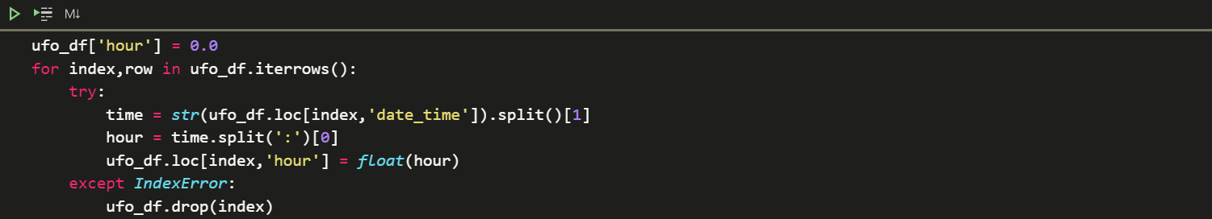
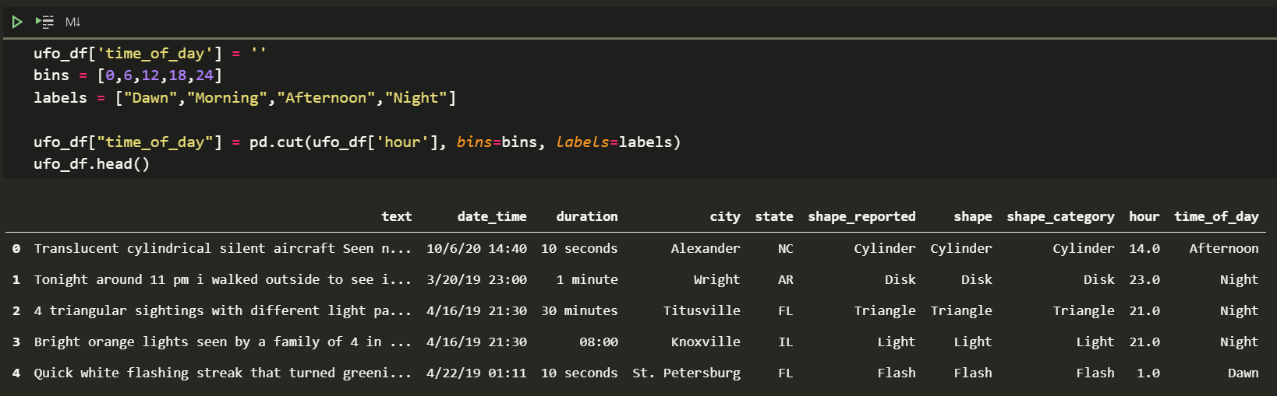
Cleaning up Date/Time

Slide 13
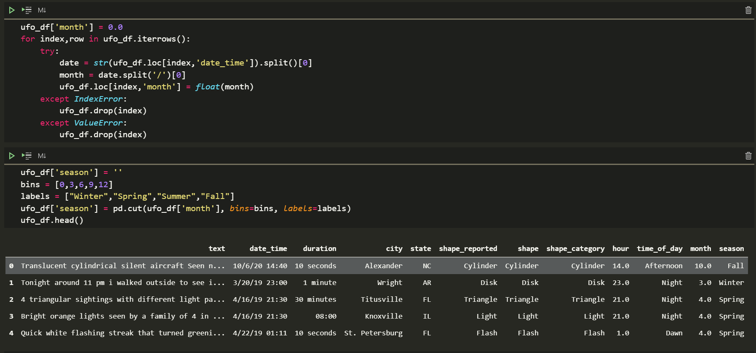
Cleaning up Date/Time

Slide 14
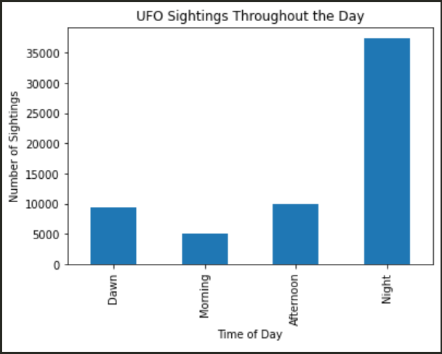
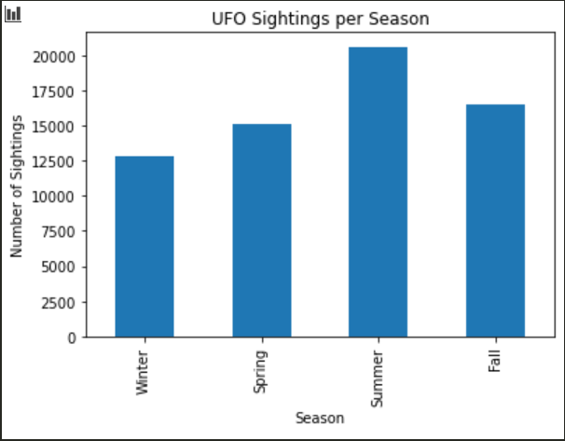
Sightings by Time/Season

Slide 15
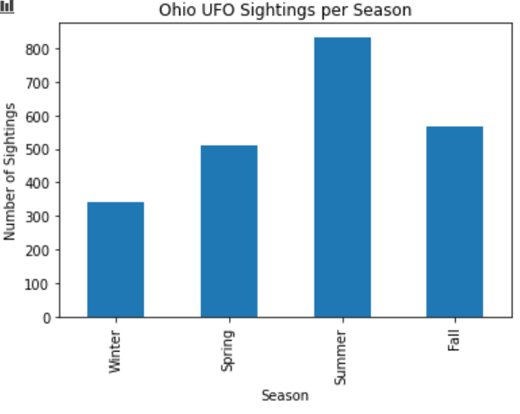
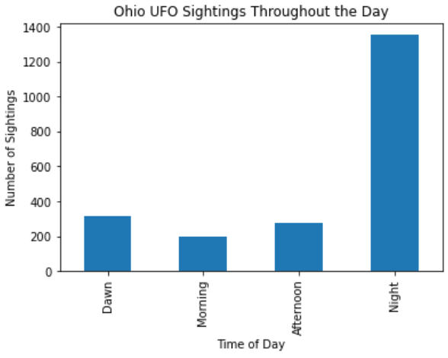
Ohio Sightings by Time/Season

Slide 16
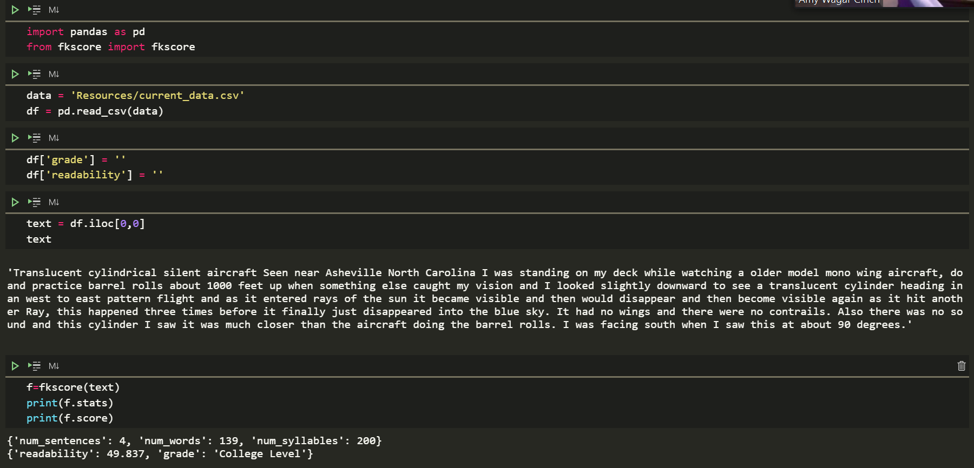
Text Readability

Slide 17
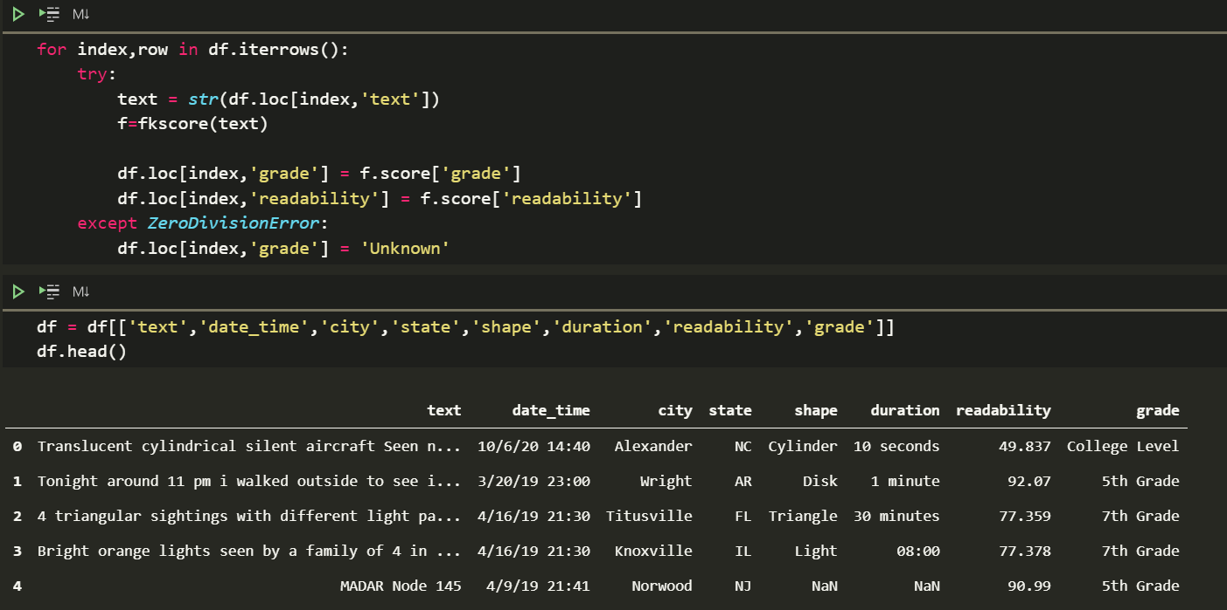
Text Readability

Slide 18
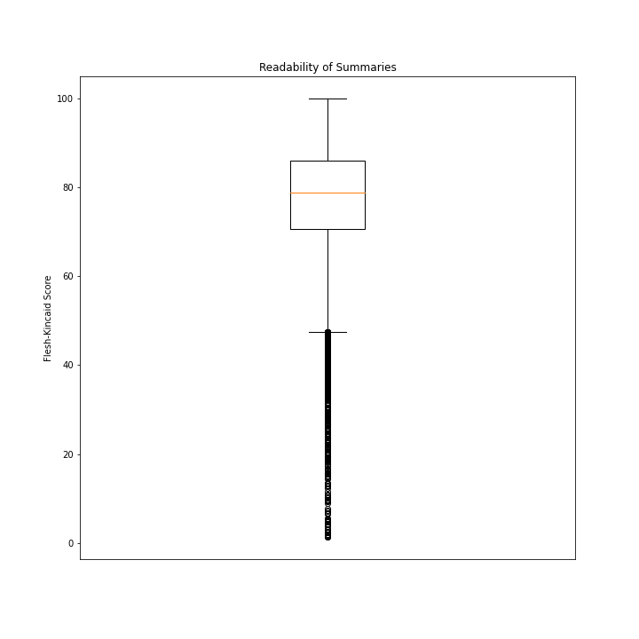
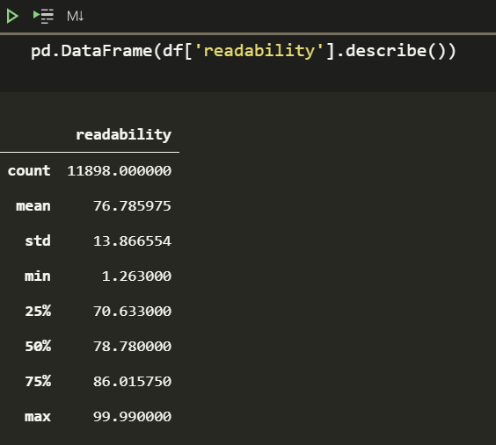
Text Readability

Slide 19
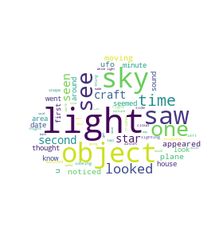
Word Cloud!
https://www.tutorialspoint.com/create-word-cloud-using-python#:~:text=%20Create%20Word%20Cloud%20using%20Python%20%201,interpreted%2C%20interactive%20and%20object-oriented%20scripting%20language.%20More%20

Slide 20
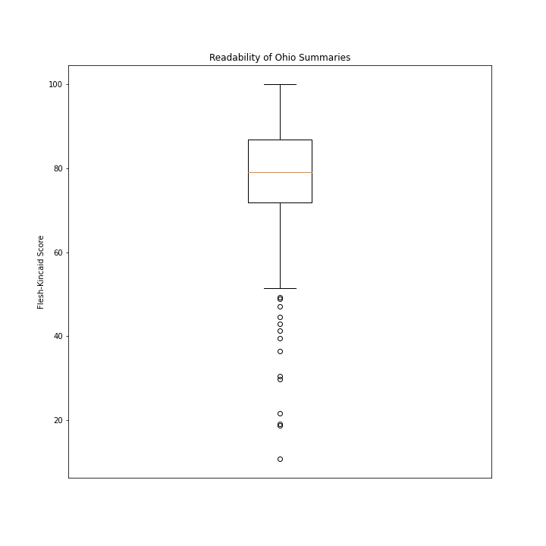
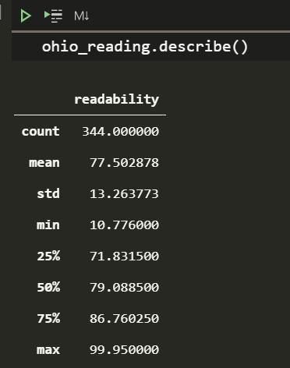
Ohio Text Readability

Slide 21
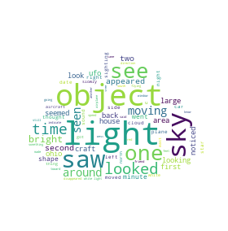
Ohio Word Cloud!

Slide 22
Washington Text Readability

Slide 23
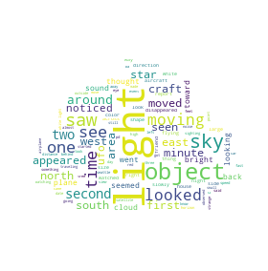
Washington Word Cloud!

